Slide 1
Autonomous Flag Finder
Burnout Squad
Jeremiah McCutcheon: Project Manager
David Koblah: Hardware Design
Michael Bates: Software Design

Slide 2
System Description
This system is an autonomous robot designed to locate, identify and retrieve flags inside a room or maze.
It will utilize a camera and proximity sensors to navigate its environment.
The camera will wirelessly communicate with a computer in order to identify flags and retrieve them.
A microcontroller will control the movement of the tank, proximity sensors and servo motors to rotate the camera or retrieve the flags.
David Koblah

Slide 3
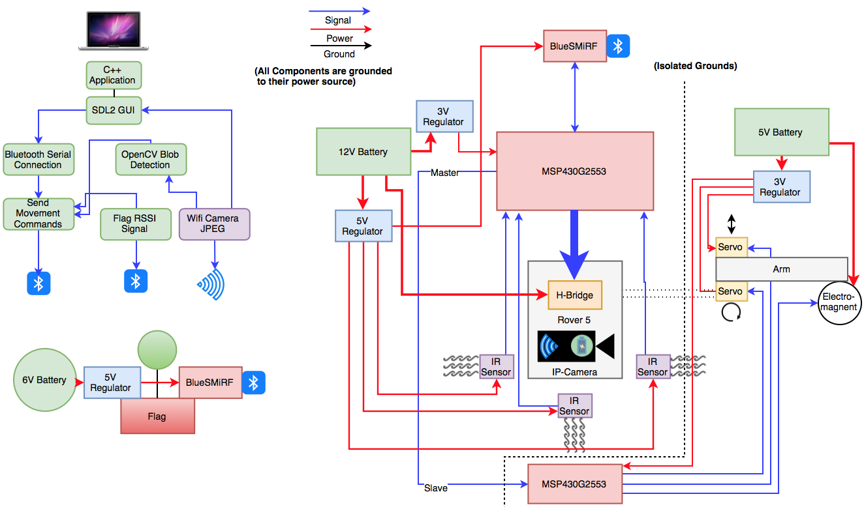
System Diagram
Jeremiah McCutcheon

Slide 4
Division of labor
Jeremiah: Bluetooth Serial Communication Interface with Mac, Video Camera Interface with Mac, Image Processing
David: BlueSMiRF receiving communication, Servo arm and Electromagnet interface, Flag Collection
Michael: Analog IR sensor implementation, Autonomous Navigation, MSP430 Code Interface, PCB, Budget
Jeremiah McCutcheon

Slide 5
Safety Concerns
Our primary safety concern this week has been managing the 9.6V battery to avoid any fires and over volting microcontroller circuits. We may also add a warning signal to our design to prevent fellow lab users from running into the rover.
Making sure not to connect to TTU with lab router.
Wearing appropriate Personal Protective Equipment
Pants
Closed Toed Shoes
Safety Glasses
Making sure to perform all painting OFF campus.
David Koblah

Slide 6
Last Week’s Deliverables
Jeremiah
Complete Blob Detection✅
Write ‘Blob Mode’ Code✅
RSSI with all 4 Blue SMiRF’s✅
Michael & David
Interface Servo Arm and Electromagnet Code with Sensor Navigation Code ✅
Run Tests with Sensor Movement and Servo Arm ❌
Finalize power distribution for the entire system ✅
Jeremiah McCutcheon

Slide 7
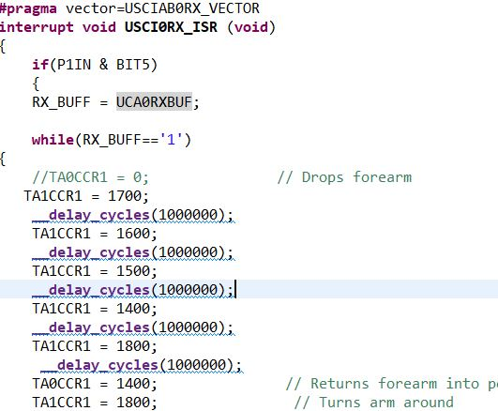
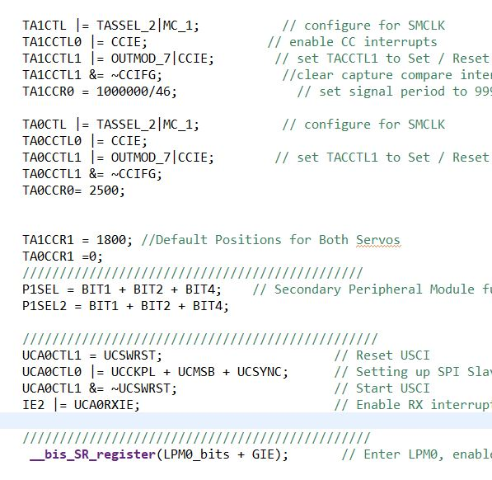
Robot Arm Slave Code Using SPI
David Koblah

Slide 8
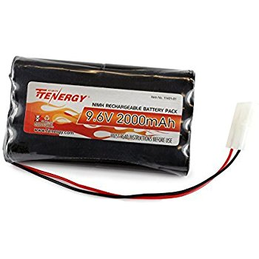
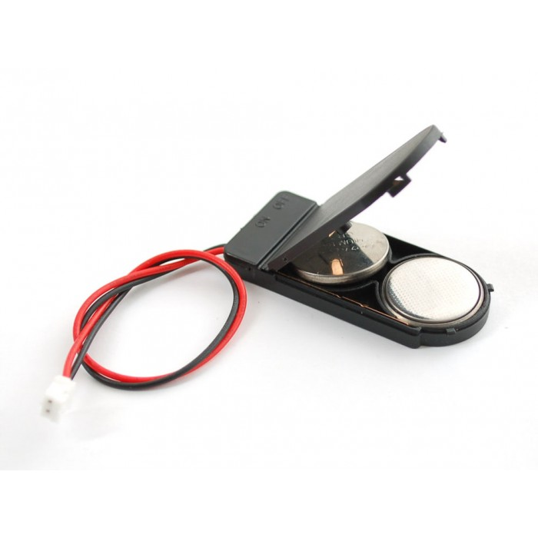
Power Solution For Flag Finder System
9.6V 2000mAh Pack [1]
Coin Battery Holder [2]
Will power Rover and Printed Circuit Board
Will power Bluetooth modules on Flags
David Koblah

Slide 9
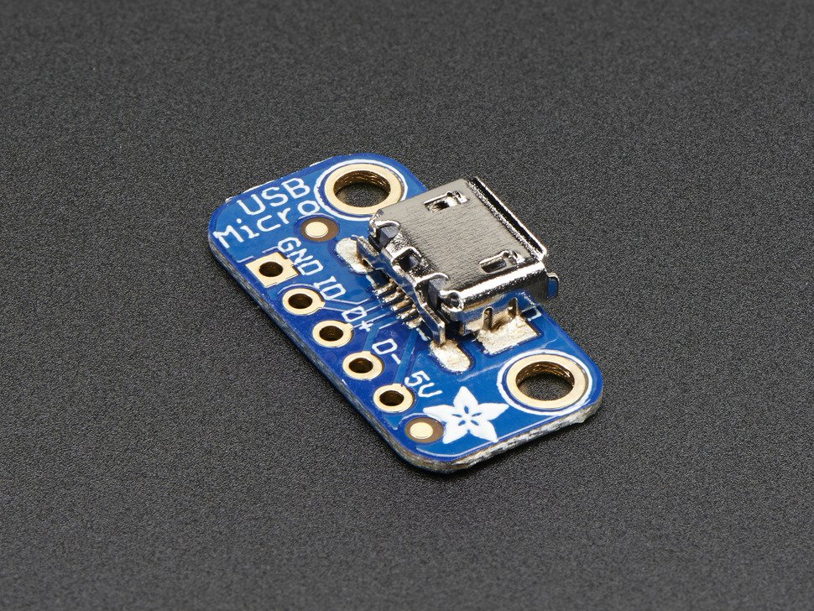
Power Solution For Flag Finder System
Adafruit [3]
Will power Servo Arm Board
David Koblah

Slide 10
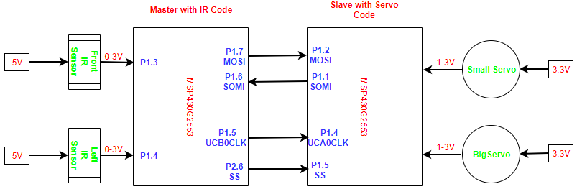
Serial Peripheral Interface (SPI)
Michael Bates

Slide 11
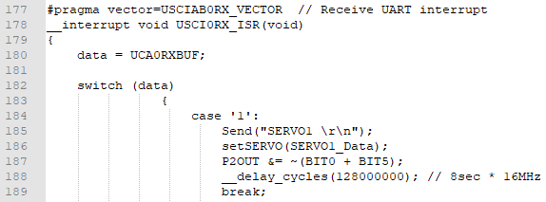
Motor Stop Servo Go Code
Disable left and right motors for 8 seconds while servo arm collects flag
Michael Bates

Slide 12
SPI Test Video and
Navigation Test Video
Michael Bates

Slide 13
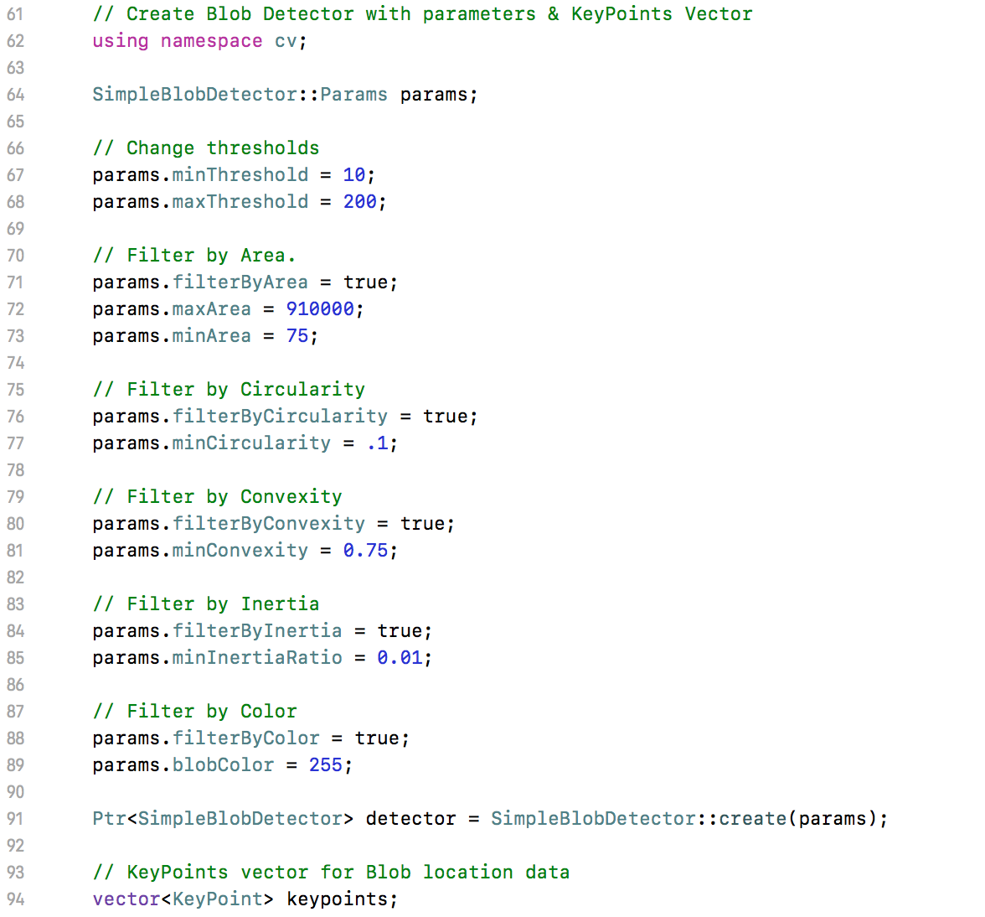
Blob Detection
Blob Parameters
Establish cv namespace &
Create parameter data structure
Create new blob detector object & KeyPoint vector
Jeremiah McCutcheon
Blob Parameters [4]

Slide 14
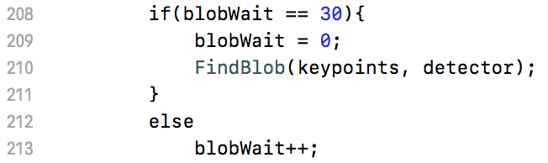
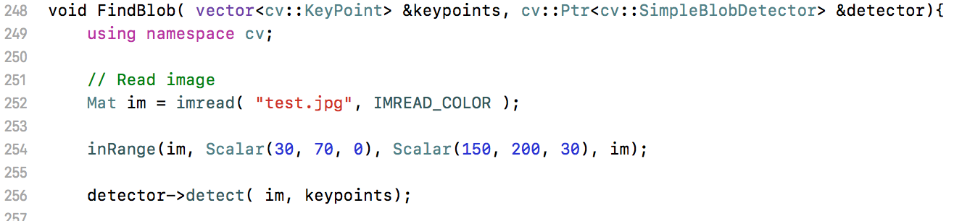
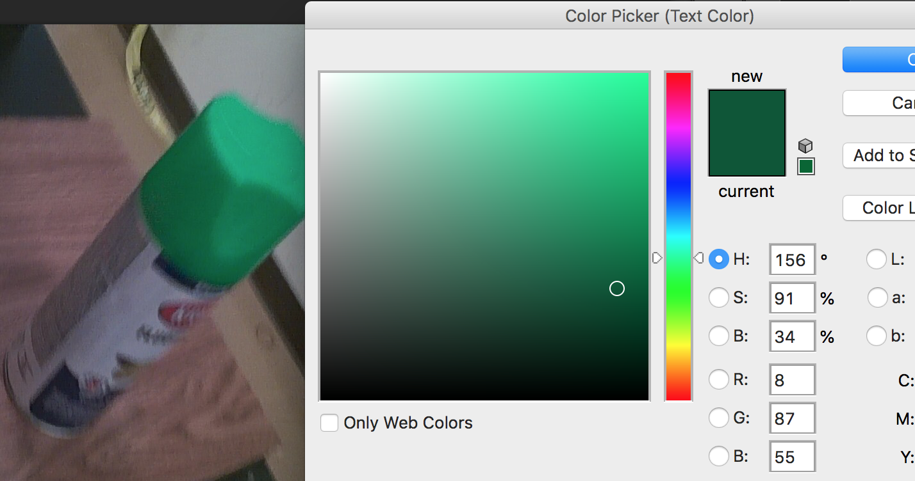
Blob Detection
Run blob detection
Isolate Green
Jeremiah McCutcheon
inRange function opencv [5]

Slide 15
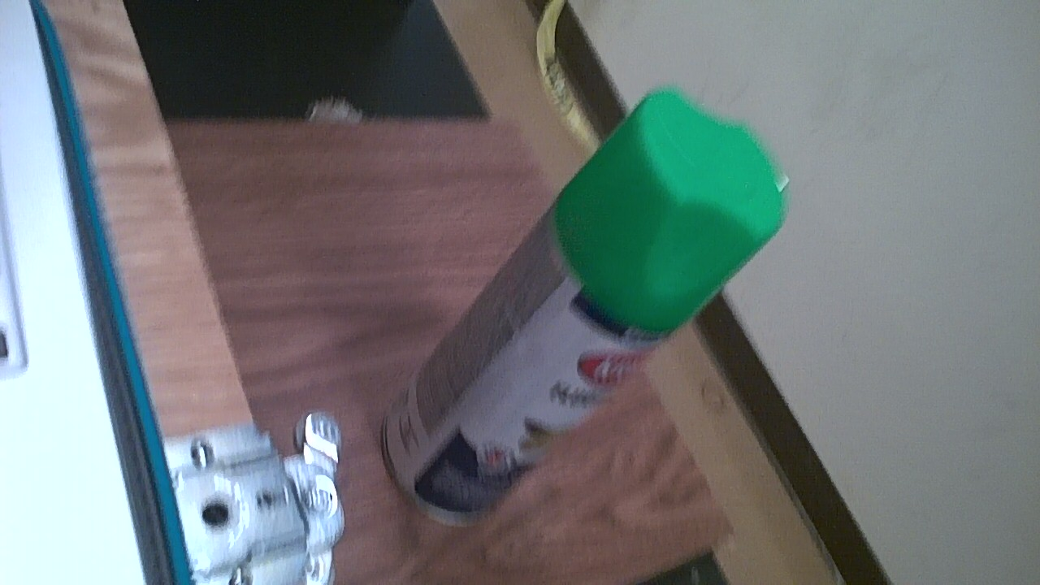

Blob Detection
Original
Green Isolated
Jeremiah McCutcheon

Slide 16
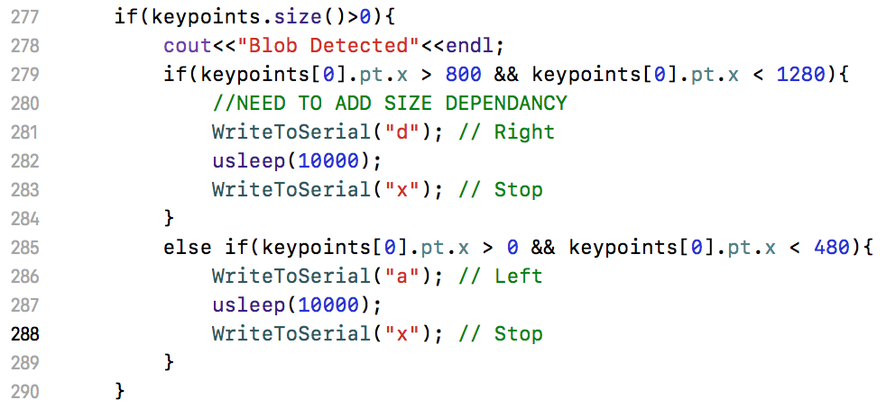
‘Blob Mode’
Blob location on image
Jeremiah McCutcheon
inRange function opencv [5]

Slide 17
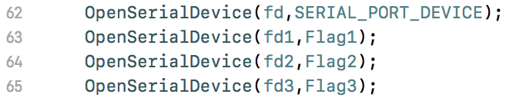
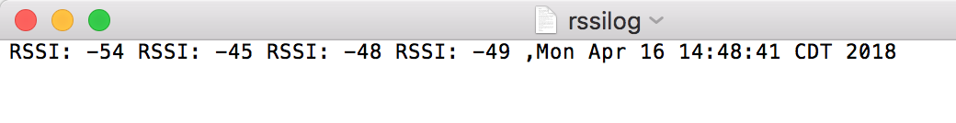
RSSI
Jeremiah McCutcheon

Slide 18
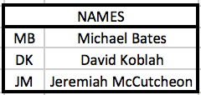
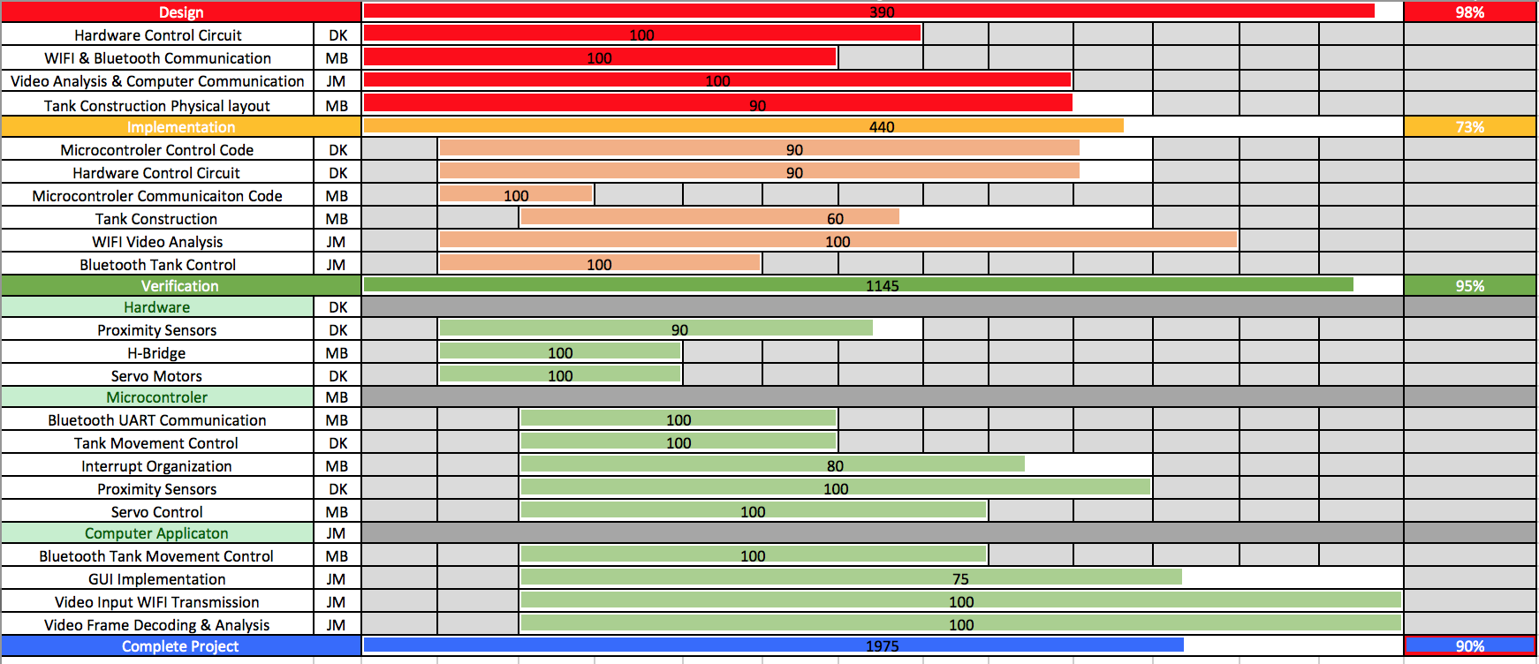
Gantt Chart
Jeremiah McCutcheon

Slide 19
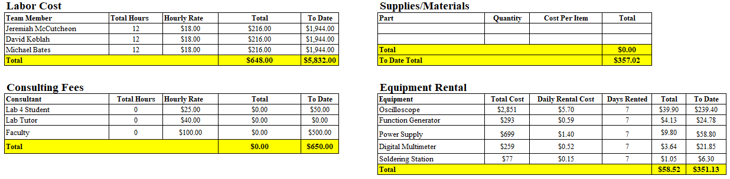
Budget
Michael Bates

Slide 20
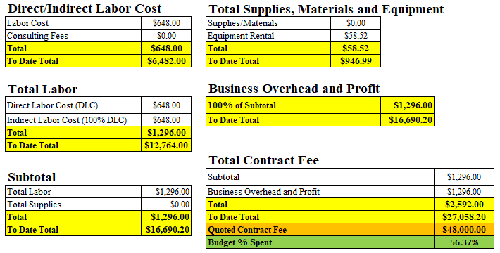
Budget Continued
Michael Bates

Slide 21
Next Week’s Deliverables
Jeremiah
Flag Retrieval tests
Figure out what to do with RSSI?
Assist with hardware and construction
Michael & David
Run Tests with Sensor Movement and Servo Arm
Construction and wire management
Complete replica PCB design using Solderable Breadboard (David)
David Koblah

Slide 22
References
[1] Robotpark- http://www.robotpark.com/2x2032-Coin-Cell-Battery-Holder-6V-output-with-On-Off-switch
[2] Amazon- https://www.amazon.com/Tenergy-Standard-Connector-Security-Rechargeable/dp/B001BA292A
[3] Adafruit, USB Micro-B Breakout Board, https://www.adafruit.com/product/1833?gclid=CjwKCAjw2dvWBRBvEiwADllhnzXv3tp1a9778W7LGTnBvy1PneBgkcm03iFKNXeWRFJ7it8sTilNjhoCUDsQAvD_BwE
[4] Blob parameters opencv: https://www.learnopencv.com/blob-detection-using-opencv-python-c/
[5] InRange function opencv: https://stackoverflow.com/questions/38082004/opencv-inrange-function
Michael Bates

Slide 23
Questions?

